Slide 1
TEAM
BABY SHARK
LYCEUM OF THE PHILIPPINES UNIVERSITY MANILA

Slide 2


TEAM
BABY SHARK
LYCEUM OF THE PHILIPPINES UNIVERSITY MANILA
#AskJuan
By the People, for the Nation

Slide 3
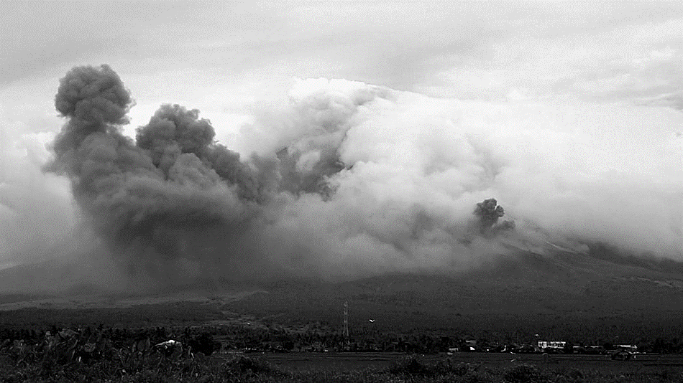
Approach
Nation Building for us
Empower our Nation
#AskJuan
Team Baby Shark LYCEUM OF THE PHILIPPINES UNIVERSITY

Slide 4
Approach
Nation Building for us
Empower our Nation
#AskJuan

